Slide 1


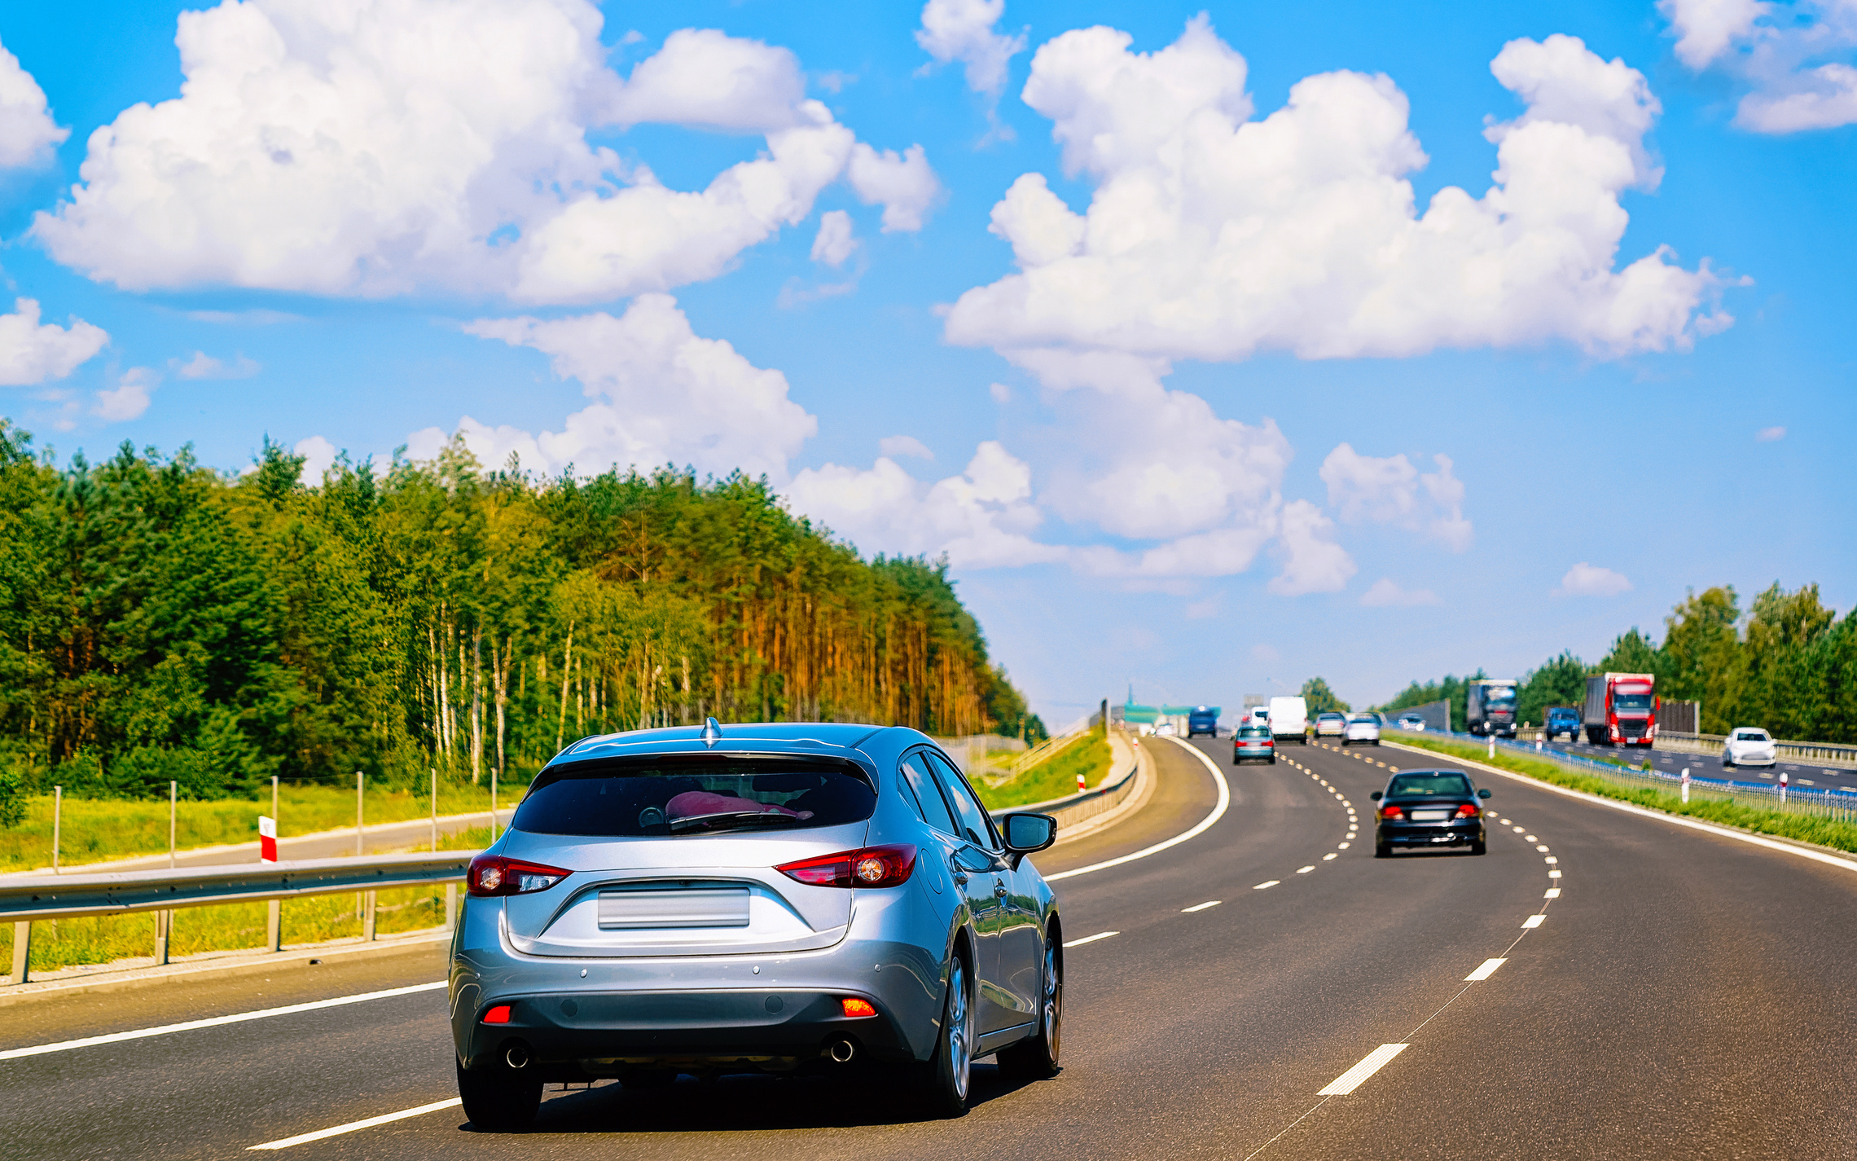

3830 PROJECT PRESENTATION
VEHICLE TRANSMISSION CLASSIFIER

Slide 2

PROBLEM STATEMENT
Build a binary classification model to predict vehicle transmission type (automatic or manual) using features such as year, make, model, mileage, and price.
OBJECTIVES
Create a reliable model to classify vehicles as having automatic or manual transmission.
Provide valuable insights to support decision-making.
Apply machine learning techniques for accurate predictions.
Build technical expertise in data analysis, visualization, and predictive modeling.
Contribute to industry engagement through actionable findings.

Slide 3

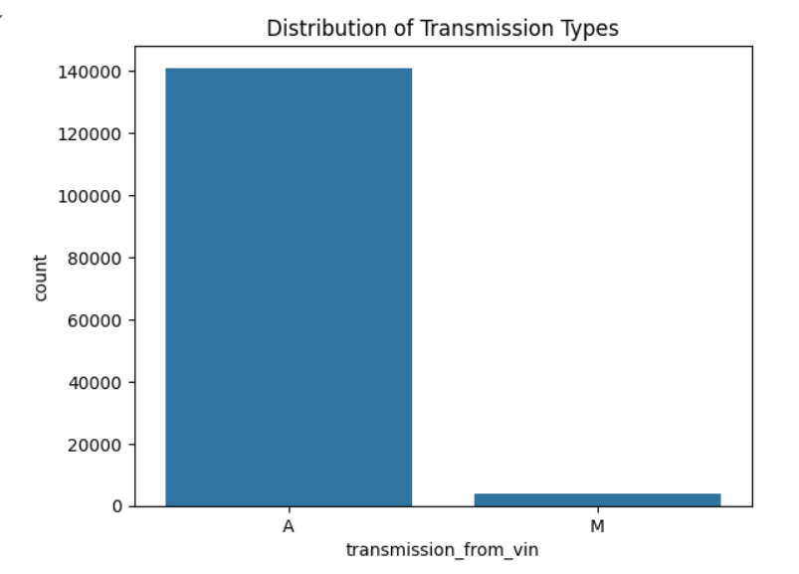
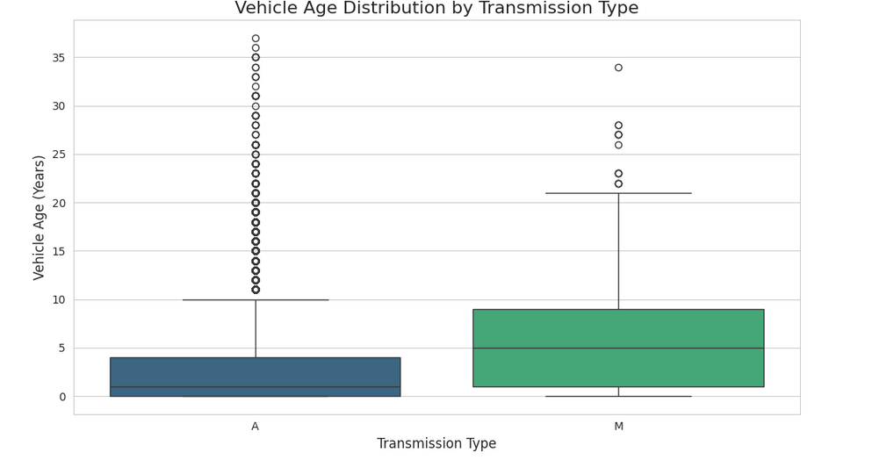
EXPLORATORY DATA ANALYSIS INSIGHTS
Encourage energy-saving habits among staff
Vehicle Age Distribution
Transmission distribution

Slide 4
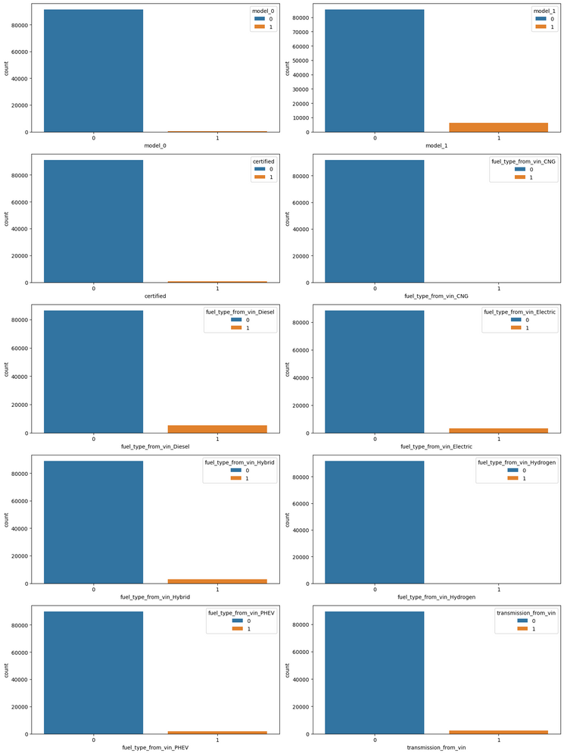
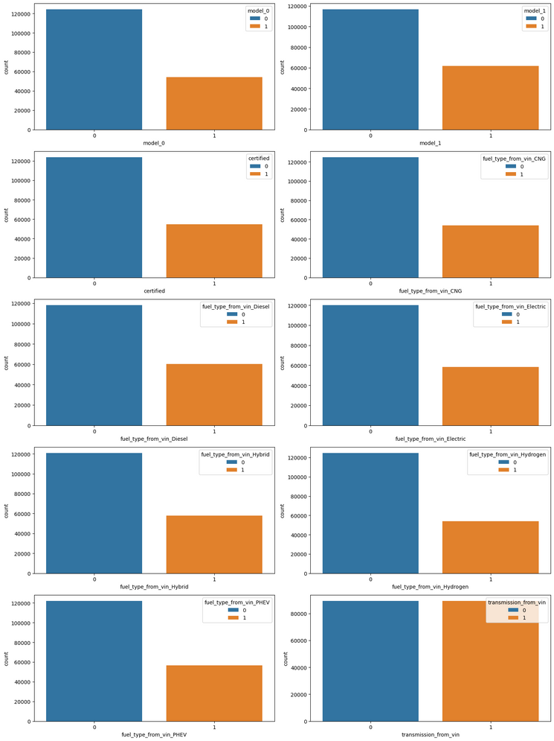
RESAMPLING (SMOTE)
Before
After
Zero Waste Initiatives

Slide 5
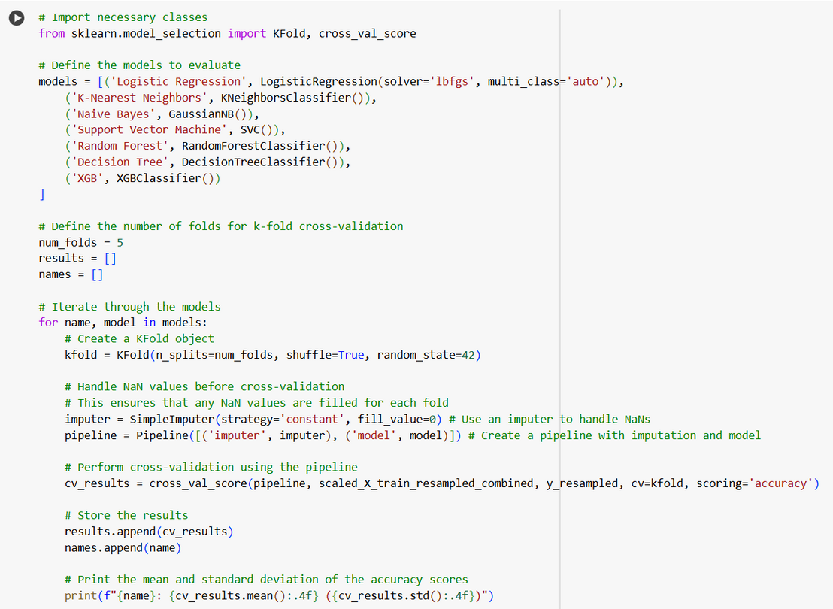
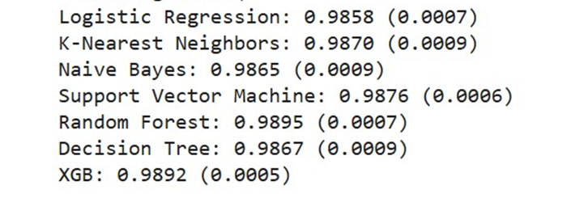
ML MODELS
Zero Waste Initiatives
Recycling and Composting

Slide 6
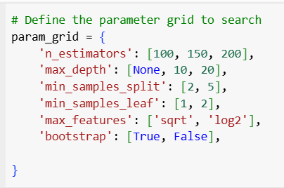
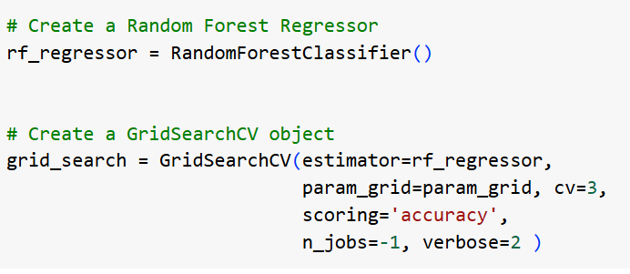
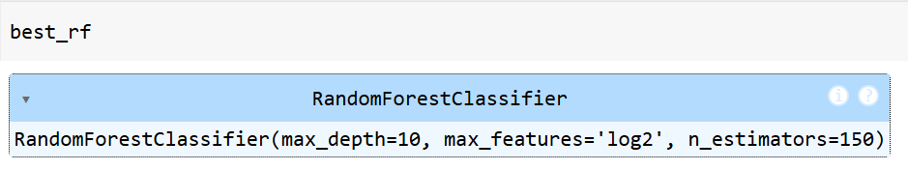
HYPERPARAMETER TUNING
Zero Waste Initiatives

Slide 7
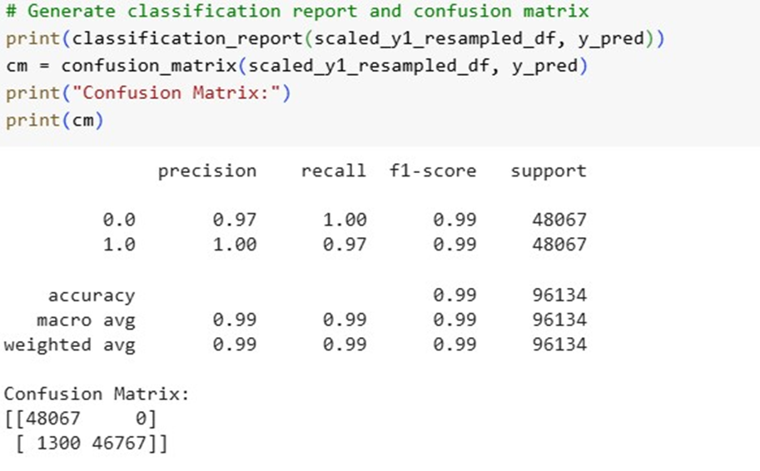
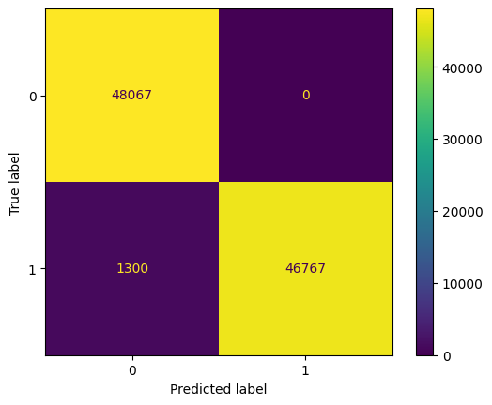

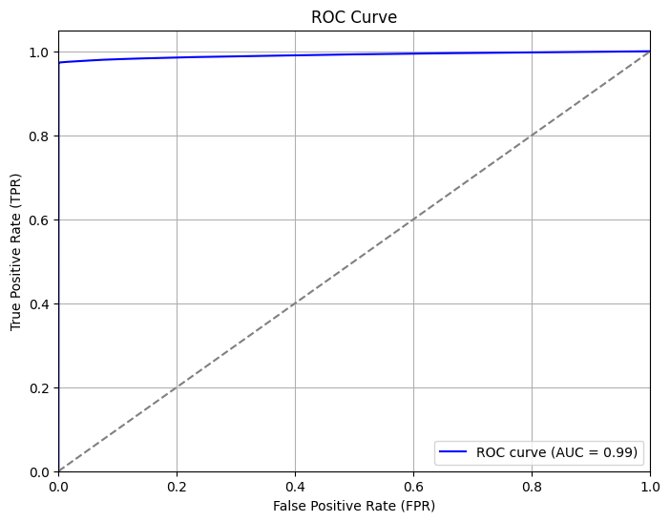
RESULTS
Classification Report
Map of Confusion Matrix

